Slide 1


مشروع تطوير البنية التحتية للمرحلة الأولى بالمنطقة اللوجستية بالمدينة الصناعية الثانية بالدمام
03/11/2026
Confidential | مقيّد

Slide 2
محتويات العرض
بيانات المشروع.
أبرز الأعمال.
حالة المشتريات الرئيسية (Long Lead Items)
خطة الأعمال الحالية والمستقبلية.
سجلات تقديم المشروع.
2026
Confidential | مقيّد

Slide 3
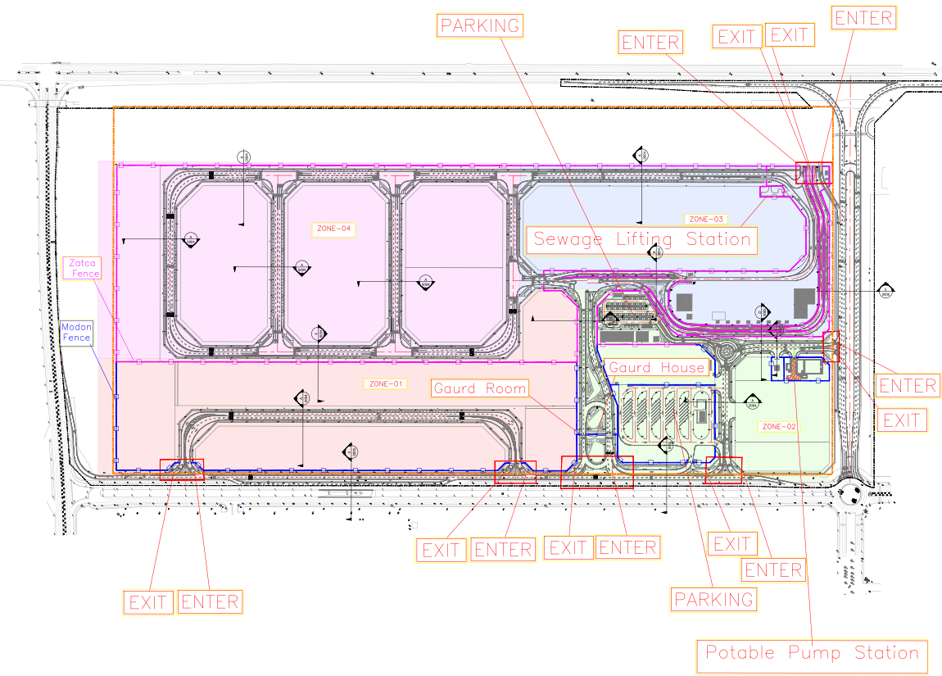
تقسيم مناطق الموقع :- Project Zones

Slide 4
1. بيانات المشروع
مدة المشروع المستهدفة
مدة المشروع التعاقدية
إجمالي قيمة المصروف
قيمة العقد (بدون ضريبة)
المقاول
الإستشاري
اسم المشروع
16 أشهر
18 شهر
62,889,674 SAR
198,906,162.61 SAR
شركة شبه الجزيرة للمقاولات
Egis
تطوير البنية التحتية للمرحلة الأولى بالمنطقة اللوجستية بالمدينة الصناعية الثانية بالدمام
30 – 11 - 2026 م
29 – 01 - 2027 م
30 – 07 - 2025 م
14 – 07 - 2025 م
30 -06- 2025 م
معالم المشروع
ملخص الأداء للمشروع
تاريخ انتهاء المشروع (مستهدف)
تاريخ انتهاء المشروع (تعاقديا)
تاريخ استلام الموقع
تاريخ توقيع العقد
تاريخ ترسية العقد على المقاول
الحالة | الأثر | المسؤول | تاريخ معالجة التحدي | الخطوات القادمة | الإجراء المتخذ / التحديث | التحدي في الموقع | #
قيد التنفيذ | تحقيق مستهدفات مدن بتقليل مدة انجاز الاعمال | المقاول | 04/2026 | زيادة عدد العمالة والمعدات للانتهاء من الشبكات الرطبة لزيادة الإنجاز في شبكات الكهرباء والبدء في اعمال الطرق | تم اسناد جزء من المشروع لمقاول آخر وتم توفير عمالة من الشركة لاستكمال الاعمال المتبقية حيث ان عدد العمالة الحالي 537 والمعدات 306 معدة والمضخات الى 24 مضخة نزح ,ووجوب استمرار زيادة العمالة والمعدات لتحقيق مستهدفات مدن | قلة عدد العمالة والمعدات وتوقف مقاول الباطن | 1
قيد التنفيذ | عدم تعطل أعمال العبارة وتحقيق مستهدفات مدن | المقاول | 10/2026 | في انتظار اعتماد شركة الكهرباء لمقترح حماية الكابل | تم الانتهاء من صب أسقف ل 32 فواصل وتم حفر 1 فاصل المتبقي | تأخر أعمال العبارة بالطريق الشرياني | 2
قيد التنفيذ | تحقيق مستهدفات مدن | المقاول | 06/2026 | استكمال العمل بشكل مباشر على الشبكات على ان يتم الانتهاء بتاريخ 19-9-2026 | تم استبعاد مقاول الباطن يوناسكو و سحب اعتماده لعدم وفاءه بمستهدفات مدن و على المقاول العمل بشكل مباشر على الشبكات او تقديم مقاول باطن للاعتماد | ضرورة الانتهاء من تنفيذ الشبكات لتحقيق جاهزية الموقع وبدء أعمال الطرق | 3
ملخص الأداء المالي للمشروع
معلّق
متأخر
قيد التنفيذ
مكتمل
Confidential | مقيّد

Slide 5
نسبة قيمة الأعمال المنجزة والأعمال الغير مصروفة
90,929,120 SAR | نسبة الأعمال المنفذة | 62,889,674 SAR | اجمالي الأعمال المصروفة حتى مستخلص 07من تاريخ 23 يونية حتى15 سبتمبر بنسبة 31.61%
45.71%
نسبة حسن التنفيذ10% بالإضافة للأعمال التي تم تسليمها بعد تاريخ 15-09-2026 | توضيح عدم الصرف | 25,381,454 SAR | اجمالي الاعمال المنفذة فعليا و التي لم تصرف
 |  | 12.76%
107,977,042 SAR | اجمالي المتبقي للصرف | 2,657,992 SAR | اعمال منفذة و جاري تسليمها
54.29% |  | 1.3%

Slide 6
NETWORK INFRASTRUCTURE SUMMARY – ALL ZONES
System / Network | Zone | Total Length (m) | Supplied (m) | Executed (m) | Supply % | Exec %
Sewerage (GRP) | Zone 1 | 1,083.58 | 1,083.58 | 1,083.58 | 100.00% | 100.00%
 | Zone 2 | 1064.92 | 1064.92 | 1064.92 | 100.00% | 100.00%
 | Zone 3 | 1,741.44 | 1,741.44 | 1,741.44 | 100.00% | 100.00%
 | Zone 4 | 2,366.92 | 2,366.92 | 2,366.92 | 100.00% | 100.00%
Sewerage (GRP) – Subtotal |  | 6,256.86 | 6,256.86 | 6,256.86 | 100.00% | 100.00%
Storm Drainage | Zone 1 | 902.55 | 902.55 | 902.55 | 100.00% | 100.00%
 | Zone 2 | 1348.17 | 1348.17 | 1348.17 | 100.00% | 100.00%
 | Zone 3 | 2,423.98 | 2,423.98 | 2,423.98 | 100.00% | 100.00%
 | Zone 4 | 2,009.41 | 2,009.40 | 2,009.41 | 100.00% | 100.00%
 | Service Road | 1,372.99 | 1,372.99 | 1,009.52 | 100.00% | 73.53%
 | Arterial Road | 455.77 | 455.77 | 455.77 | 100.00% | 100.00%
Storm Drainage – Subtotal |  | 8,512.87 | 8,512.86 | 8,149.40 | 100.00% | 95.73%
Potable Water (HDPE) | Zone 1 | 864 | 864 | 864 | 100.00% | 100.00%
 | Zone 2 | 2,417.00 | 2,417.00 | 1,431.00 | 100.00% | 59.21%
 | Zone 3 | 1,103.00 | 1,103.00 | 900.00 | 100.00% | 81.60%
 | Zone 4 | 2,833.00 | 2,833.00 | 2,833.00 | 100.00% | 100.00%
Potable Water (HDPE) – Subtotal |  | 7,217.00 | 7,217.00 | 6,028.00 | 100.00% | 83.53%
Irrigation (HDPE) | Zone 1 | 3,256.00 | 3,256.00 | 775.00 | 100.00% | 23.80%
 | Zone 2 | 4,599.00 | 2,754.00 | 975.00 | 59.88% | 21.20%
 | Zone 3 | 2,397.00 | 1,855.00 | 708.00 | 77.39% | 29.54%
 | Zone 4 | 7,426.00 | 3,663.00 | 2,595.00 | 49.33% | 34.94%
Irrigation (HDPE) – Subtotal |  | 17,678.00 | 11,528.00 | 5,053.00 | 65.21% | 28.58%
Catch Basin (UPVC) | Zone 1 | 1,169.00 | 1,169.00 | 1,169.00 | 100.00% | 100.00%
 | Zone 2 | 1,975.00 | 1,975.00 | 1,800.00 | 100.00% | 91.14%
 | Zone 3 | 2,173.00 | 2,173.00 | 1,978.00 | 100.00% | 91.03%
 | Zone 4 | 1,171.00 | 1,171.00 | 1,171.00 | 100.00% | 100.00%
Catch Basin (UPVC) – Subtotal |  | 6,488.00 | 6,488.00 | 6,118.00 | 100.00% | 94.30%
Fire Fighting (HDPE) | Zone 1 | 985.00 | 985.00 | 985.00 | 100.00% | 100.00%
 | Zone 2 | 1,622.68 | 1,622.68 | 1,597.00 | 100.00% | 98.42%
 | Zone 3 | 1,217.00 | 1,217.00 | 1,017.00 | 100.00% | 83.57%
 | Zone 4 | 2,819.00 | 2,819.00 | 2,819.00 | 100.00% | 100.00%
Fire Fighting (HDPE) – Subtotal |  | 6,643.68 | 6,643.68 | 6,418.00 | 100.00% | 96.60%
GRAND TOTAL – ALL SYSTEMS |  | 52,796.41 | 46,646.40 | 38,023.26 | 88.35% | 72.02%

Slide 7
حالة توريد و تركيب مصائد السيول والمناهل
# | Manhole of Storm Network
ZONE | Zone 1 | Zone 2 | Zone 3 | Zone 4 | Service Road | Arterial Road | SUM
QUANTITY | 14 | 38 | 48 | 34 | 20 | 6 | 160
DELIVERY | 14 | 38 | 48 | 34 | 20 | 6 | 160
EXECUTED | 14 | 38 | 48 | 34 | 15 | 6 | 155
# | Catch Basin Network
ZONE | Zone 1 | Zone 2 | Zone 3 | Zone 4 | Service Road | Arterial Road | SUM
QUANTITY | 25 | 77 | 110 | 68 | 42 | 16 | 338
DELIVERY | 25 | 77 | 110 | 68 | 42 | 16 | 338
EXECUTED | 25 | 74 | 100 | 68 | 5 | 16 | 288
# | Manhole of Sewage Network
ZONE | Zone 1 | Zone 2 | Zone 3 | Zone 4 | Service Road | Arterial Road | SUM
QUANTITY | 23 | 38 | 25 | 50 | 0 | 0 | 136
DELIVERY | 23 | 38 | 25 | 50 | 0 | 0 | 136
EXECUTED | 23 | 38 | 25 | 50 | 0 | 0 | 136
Chamber & Fire Hydrant For Potable , Irrigation and Fire fighting
# | Zone 1 |  | Zone 2 |  | Zone 3 |  | Zone 4 |  | All Zone
 | Sum | Excuted | Sum | Excuted | Sum | Excuted | Sum | Excuted | SUM | Excuted
Wash Out Chamber | 2 | 2 | 10 | 6 | 3 | 3 | 4 | 4 | 19 | 15
Air Chamber | 3 | 3 | 6 | 3 | 5 | 5 | 8 | 8 | 22 | 19
Flow Meter | 0 | 0 | 1 | 0 | 0 | 0 | 0 | 0 | 1 | 0
SUM | 5 | 5 | 17 | 9 | 8 | 8 | 12 | 12 | 42 | 34
Fire Hydrant | 13 | 11 | 21 | 0 | 11 | 0 | 37 | 1 | 82 | 12
# | Wash Out Chamber | Air Chamber | Flow Meter | Fire Hydrant
QUANTITY | 19 | 22 | 1 | 82
DELIVERY | 18 | 21 | 0 | 12
EXECUTED | 15 | 19 | 0 | 12

Slide 8

Detailed Zonal Recovery Plan Status – Project scope finish dates
Development Of Infrastructure For Phase 1 Of The Logistics Area At The 2nd Industrial City In Dammam Recovery Level 03 Schedule Data Date 03/11/2026 | Project Start | Forecast Finish | Planned % | Progress % | Variance
Total | Started | 12/20/2026
Zone 01 | Started | 12/5/2026
Sewerage Network | Started | Finished | 100.00% | 100.00% | 0.00%
Strom Water Network | Started | Finished | 100.00% | 100.00% | 0.00%
Potable Water Network | Started | Finished | 100.00% | 100.00% | 0.00%
Fire Fighting Network | Started | Finished | 100.00% | 100.00% | 0.00%
TSE Network | Started | 11/10/2026 | 98.33% | 79.29% | -19.04%
Medium Voltage Network | Started | 10/3/2026 | 100.00% | 95.81% | -4.19%
Low Voltage Network | Started | Finished | 94.24% | 100.00% | 5.76%
Street Lighting Network | Started | 11/17/2026 | 94.58% | 96.98% | 2.40%
Telecommunication Network | Started | 9/24/2026 | 100.00% | 91.06% | -8.94%
Road Works | Started | 10/21/2026 | 100.00% | 88.77% | -11.23%
Subgrade | Started | Finished | 100.00% | 100.00% | 0.00%
Aggregate Base Coarse | Started | 10/6/2026 | 100.00% | 94.10% | -5.90%
Asphalt Base Coarse | Started | 10/13/2026 | 100.00% | 96.80% | -3.20%
Asphalt Wearing Coarse | 10/14/2026 | 10/21/2026 | 100.00% | 0.00% | -100.00%
Landscape | 11/16/2026 | 12/5/2026 | 0.00% | 0.00% | 0.00%
Zone 02 | Started | 12/20/2026
Sewerage Network | Started | 11/3/2026 | 100.00% | 93.75% | -6.25%
Strom Water Network | Started | 11/7/2026 | 100.00% | 95.44% | -4.56%
Potable Water Network | Started | 11/7/2026 | 94.90% | 65.93% | -28.97%
Fire Fighting Network | Started | 11/24/2026 | 87.29% | 61.79% | -25.50%
TSE Network | Started | 10/17/2026 | 100.00% | 2.17% | -97.83%
Medium Voltage Network | 9/16/2026 | 11/22/2026 | 74.56% | 0.00% | -74.56%
Low Voltage Network | 10/11/2026 | 11/4/2026 | 99.09% | 0.00% | -99.09%
Street Lighting Network | 9/20/2026 | 11/26/2026 | 40.02% | 0.00% | -40.02%
Telecommunication Network | 10/10/2026 | 11/24/2026 | 51.93% | 0.00% | -51.93%
Road Works | Started | 11/18/2026 | 47.98% | 34.14% | -13.84%
Subgrade | Started | 11/1/2026 | 100.00% | 49.65% | -50.35%
Aggregate Base Coarse | Started | 11/3/2026 | 100.00% | 48.67% | -51.33%
Asphalt Base Coarse | Started | 11/16/2026 | 43.16% | 39.22% | -3.94%
Asphalt Wearing Coarse | 10/24/2026 | 11/18/2026 | 13.02% | 0.00% | -13.02%
Landscape | 10/14/2026 | 12/20/2026 | 5.98% | 0.00% | -5.98%
Development Of Infrastructure For Phase 1 Of The Logistics Area At The 2nd Industrial City In Dammam Recovery Level 03 Schedule Data Date 03/11/2026 | Project Start | Forecast Finish | Planned % | Progress % | Variance
Zone 03 | Started | 12/9/2026
Sewerage Network | Started | 10/19/2026 | 100.00% | 89.74% | -10.26%
Strom Water Network | Started | 10/4/2026 | 100.00% | 98.97% | -1.03%
Potable Water Network | Started | 10/27/2026 | 100.00% | 88.87% | -11.13%
Fire Fighting Network | Started | 11/22/2026 | 90.98% | 70.60% | -20.38%
TSE Network | Started | 11/15/2026 | 99.87% | 17.45% | -82.42%
Medium Voltage Network | Started | 11/19/2026 | 91.29% | 42.94% | -48.35%
Low Voltage Network | Started | 11/18/2026 | 98.08% | 4.12% | -93.96%
Street Lighting Network | Started | 11/29/2026 | 61.79% | 49.22% | -12.57%
Telecommunication Network | Started | 11/4/2026 | 99.98% | 73.51% | -26.47%
Road Works | Started | 11/26/2026 | 45.42% | 17.28% | -28.14%
Subgrade | Started | 10/25/2026 | 100.00% | 34.99% | -65.01%
Aggregate Base Coarse | Started | 11/11/2026 | 49.15% | 16.12% | -33.03%
Asphalt Base Coarse | Started | 11/16/2026 | 59.78% | 24.52% | -35.26%
Asphalt Wearing Coarse | 10/14/2026 | 11/26/2026 | 5.53% | 0.00% | -5.53%
Landscape | 11/20/2026 | 12/9/2026 | 0.00% | 0.00% | 0.00%
Zone 04 | Started | 12/20/2026
Sewerage Network | Started | 10/7/2026 | 100.00% | 98.74% | -1.26%
Strom Water Network | Started | Finished | 100.00% | 100.00% | 0.00%
Potable Water Network | Started | 11/12/2026 | 99.21% | 88.60% | -10.61%
Fire Fighting Network | Started | 10/31/2026 | 100.00% | 82.75% | -17.25%
TSE Network | Started | 11/22/2026 | 82.05% | 74.25% | -7.80%
Medium Voltage Network | Started | 10/29/2026 | 100.00% | 92.18% | -7.82%
Low Voltage Network | Started | 11/1/2026 | 100.00% | 30.81% | -69.19%
Street Lighting Network | Started | 10/26/2026 | 100.00% | 82.19% | -17.81%
Telecommunication Network | Started | 11/7/2026 | 99.26% | 90.88% | -8.38%
Road Works | Started | 11/18/2026 | 60.23% | 47.02% | -13.21%
Subgrade | Started | 9/28/2026 | 100.00% | 99.81% | -0.19%
Aggregate Base Coarse | Started | 10/4/2026 | 100.00% | 87.19% | -12.81%
Asphalt Base Coarse | Started | 10/13/2026 | 100.00% | 63.24% | -36.76%
Asphalt Wearing Coarse | 10/17/2026 | 11/18/2026 | 7.03% | 0.00% | -7.03%
Landscape | 11/10/2026 | 12/20/2026 | 0.00% | 0.00% | 0.00%
Other Roads | Started | 11/19/2026
Service Road Z01&02 | Started | 11/19/2026 | 86.43% | 27.56% | -58.87%
Arterial Road Z02&03 | Started | 11/8/2026 | 97.03% | 56.71% | -40.32%
Project Structures | Started | 12/12/2026
Potable Water Pump Station | Started | 11/26/2026 | 84.79% | 15.74% | -69.05%
Sewage Lift Station | Started | 11/22/2026 | 42.61% | 3.40% | -39.21%
Box Culvert | Started | 11/7/2026 | 99.86% | 86.77% | -13.09%
Guard Rooms ( Guard House & 3 Guard Room) | Started | 11/25/2026 | 58.52% | 26.34% | -32.18%
MODON Fence (2,725 LM) | Started | 12/12/2026 | 52.07% | 4.57% | -47.50%
ZATCA Fence (6,985 LM) | 8/15/2026 | 12/9/2026 | 44.61% | 0.00% | -44.61%

Slide 9


Cashflow Rectification
Development Of Infrastructure For Phase 1 Of The Logistics Area At The 2nd Industrial City In Dammam Acceleration Plan - S-Curve
Acceleration Plan | Sep-26 |  | Oct-26 |  |  |  | Nov-26 |  |  |  | Dec-26 |  |  |  |  | Jan-27
 | 22/09/2026 | 29/09/2026 | 06/10/2026 | 13/10/2026 | 20/10/2026 | 27/10/2026 | 03/11/2026 | 10/11/2026 | 17/11/2026 | 24/11/2026 | 01/12/2026 | 08/12/2026 | 15/12/2026 | 22/12/2026 | 29/12/2026 | 05/01/2027 | 12/01/2027 | 19/01/2027 | 26/01/2027 | 29/01/2027
Weekly - Acceleration Plan | 8,971,056.18 | 6,187,860.97 | 7,788,358.30 | 9,125,770.80 | 9,616,318.13 | 9,804,159.61 | 9,540,990.07 | 11,589,582.69 | 11,571,923.30 | 5,688,040.38 | 3,152,959.91 | 1,768,671.96 | 2,816,959.18 | 3,668,466.59
Weekly - Acceleration Plan % | 4.51% | 3.11% | 3.92% | 4.59% | 4.83% | 4.93% | 4.80% | 5.83% | 5.82% | 2.86% | 1.59% | 0.89% | 1.42% | 1.84% | 0.00% | 0.00% | 0.00% | 0.00% | 0.00% | 0.00%
Cumm. Weekly - Acceleration Plan | 107,982,227.93 | 114,170,088.90 | 122,023,490.87 | 131,535,289.53 | 140,538,384.62 | 151,583,083.67 | 160,430,608.84 | 171,534,362.98 | 183,045,700.16 | 187,840,711.02 | 190,926,983.89 | 192,634,758.79 | 195,677,912.02 | 198,906,162.61 | 198,906,162.61 | 198,906,162.61 | 198,906,162.61 | 198,906,162.61 | 198,906,162.61 | 198,906,162.61
Cumm. Weekly - Acceleration Plan% | 54.29% | 57.40% | 61.35% | 66.13% | 70.66% | 76.21% | 80.66% | 86.24% | 92.03% | 94.44% | 95.99% | 96.85% | 98.38% | 100.00% | 100.00% | 100.00% | 100.00% | 100.00% | 100.00% | 100.00%

Slide 10
أعمال المخططات واعتمادات المواد Engineering
Shop Drawings Submittals Status |  |  |  |  | 13/04/2026
Discipline | Total Submitted | Approved | Rejected | Under Review | % Approved
Civil /Roads | 932 | 932 | 0 | 0 | 100.00%
Sewer Network | 40 | 40 | 0 | 0 | 100.00%
Storm Network | 38 | 38 | 0 | 0 | 100.00%
Potable Network | 20 | 20 | 0 | 0 | 100.00%
Fire Fighting Network | 25 | 25 | 0 | 0 | 100.00%
Irrigation Network | 21 | 21 | 0 | 0 | 100.00%
Lateral Irrigation | 187 | 187 | 0 | 0 | 100.00%
Electrical | 41 | 41 | 0 | 0 | 100.00%
Landscape | 218 | 218 | 0 | 0 | 100.00%
Structural | 175 | 175 | 0 | 0 | 100.00%
MEP | 68 | 68 | 0 | 0 | 100.00%
Architectural | 53 | 53 | 0 | 0 | 100.00%
TOTAL | 1818 | 1818 | 0 | 0 | 100.00%
Material Submittals
في انتظار الموافقة | مع الكود C | مع الكود B | مع الكود A | Total | أغراض | #
0 | 2 | 50 | 1 | 53 | Structural | 1
1 | 0 | 37 | 0 | 39 | Mechanical | 3
0 | 2 | 36 | 0 | 38 | Electrical | 4
1 | 4 | 123 | 1 | 130 | TOTAL
Confidential | مقيّد

Slide 11
3. حالة المشتريات الرئيسية (Long Lead Items - Electrical)
Item Description | Discipline | (Long \Short) | Unit | Quantity | Proc. Qty | Planed P.O Date | Date of Pur. Order Issued | Purchase Order No. | Supplier | Supplier Phone | Start Manufacturing Date | Required on Job | Es.D.A. to Site | Finish.D.A. to Site | P.O % | Approval Status | Delivery Qty
PLC System | Electrical | LL | Unit | 1.00 | 1.00 | 01/01/2026 | 23/11/2025 | Jc/026Dm/25 | Siemens Limited AGU | Mahmoud Hassan 0539124686 | 11/7/2026 | 01/10/2026 | 15/07/2026 | 30/11/2026 | 60% | B | 0.00
Hydrostatic level meter, level switches, and all accessories | Electrical | LL | Unit | 2.00 | 2.00 | 24/10/2025 | 23/11/2025 | Jc/027Dm/25 | Siemens Limited AGU | Mahmoud Hassan 0539124686 | 11/7/2026 | 01/10/2026 | 15/09/2026 | 30/11/2026 | 60% | B | 0.00
Street Lighting Poles & accessories | Electrical | LL | Unit | 565.00 | 565.00 | 07/02/2026 | 30/11/2025 | DAM-251229 | Saudi Co. for Lighting Fixtures (SACLF) | Ayman 0510546706 | 1/7/2026 | 16/08/2026 | 30/03/2026 | 15/11/26 | 100% | B | 377.00
Steet Lighting Cables & Acessories | Electrical | LL | Lm | 20,000.00 | 20,000.00 | 07/02/2026 | 27/11/2025 | DAM-251228 | Jeddah Cable | Amjad 0561792045 | 1/7/2026 | 16/08/2026 | 09/09/26 | 15/11/26 | 25% | B | 6054
Street Lighting Luminaires | Electrical | LL | Unit | 632.00 | 632.00 | 07/02/2026 | 30/11/2025 | DAM-251229 | SLC/Philips | Ayman 0510546706 | 1/7/2026 | 16/08/2026 | 30/06/2026 | Delivered | 100% | B | 632.00
RMU -SEC Ring main units 17KV | Electrical | LL | Unit | 5.00 | 5.00 | 30/12/2025 | 10/01/2026 | DAM-251231 | Al-Ojaimi Factory | Hashim 0558092903 | 15/01/2026 | 16/08/2026 | Within 2W | 15/11/26 | 40% | B | 0.00
Capacitor Bank | Electrical | LL | Unit | 2.00 | 2.00 | 30/12/2025 | 20/12/2025 | Jc/019Dm/25 | Schneider-MOTS | Muhamad Zubair 0508195967 | 05/01/2026 | 1/10/2026 | 15/09/2026 | 30/11/2026 | 70% | B | 0.00
ATS Panel | Electrical | LL | Unit | 2.00 | 2.00 | 15/01/2026 | 20/12/2025 | Jc/019Dm/25 | Schneider-MOTS | Muhammad Zubair 0508195967 | 10/01/2026 | 01/10/2026 | 12/09/2026 | 30/11/2026 | 70% | B | 1.00
MCC-Motor control centres | Electrical | LL | Unit | 2.00 | 2.00 | 20/01/2026 | 20/12/2025 | Jc/019Dm/25 | Schneider-MOTS | Muhamad Zubair 0508195967 | 05/01/2026 | 01/10/2026 | 15/09/2026 | 30/11/2026 | 70% | B | 0.00
Local Control Panel/ Monitoring Control Panel | Electrical | LL | Unit | 5.00 | 5.00 | 15/01/2026 | 20/12/2025 | Jc/019Dm/25 | Schneider-MOTS | Muhamad Zubair 0508195967 | 05/01/2026 | 01/10/2026 | 22/09/2026 | 30/11/2026 | 100% | B | 0.00
Units Substations 13.8 KV/400V | Electrical | LL | Unit | 3.00 | 3.00 | 30/12/2025 | 10/01/2026 | DAM-251231 | Al-Ojaimi Factory | Hashim 0558092903 | 01/01/2026 | 21/06/2026 | Within 2W | 30/10/26 | 40% | B | 0.00
MV Cable & Accessories | Electrical | LL | Lm | 12,600.00 | 12,600.00 | 20/02/2026 | 15/12/2025 | DAM-151229 | Jeddah Cable | Amjad 0561792045 | 27/11/2025 | 30/01/2026 | 15/01/2026 | Delivered | 100% | B | 12,600.00
LV Panels Boards & LV Feeder Pillars (street lighting& distribution) | Electrical | LL | Unit | 3.00 | 0.00 | 01/02/2026 | 24/02/2026 | DAM-260203 | Effective Power | Hatem Eldawy 0552073640 | 26/02/2026 | 07/07/2026 | 25/10/26 | Delivered | 50% | B | 03.00
Confidential | مقيّد

Slide 12
3. حالة المشتريات الرئيسية (Long Lead Items - Mechanical)
Item Description | Discipline | (Long \Short) | Unit | Quantity | Proc. Qty | Planned P.O Date | Date of Pur. Order Issued | Purchase Order No. | Supplier | Supplier Phone | Start Manufacturing Date | Required on Job | Es. D.A. to Site | Finished. to Site | P.O % | Approval Status | Delivery Qty
DI Pipes & Fittings | Mechanical | LL | LM | 75.00 | 75.00 | 08/11/2025 | 08/11/2025 | OD/QS34529/04/2026 | SPS | Mohammad Eid 050 527 5340 | 15/04/2026 | 24/06/2026 | 05/08/2026 | Delivered | 100% | B | 75
Valves & Accessories & Fittings | Mechanical | LL | Unit | 121.00 | 121.00 | 24/11/2025 | 20/11/2026 | UCC-C6-046 | SPS | Mohammad Eid 050 527 5340 | 02/12/2025 | 18/12/2025 | 05/08/2026 | 30/11/26 | 100% | B | 61.00
Fire Hydrant | Mechanical | LL | Unit | 82.00 | 82.00 | 15/10/2025 | 08/11/2025 | UCC-C6-004 | SFFECO | Repy 0533723157 | 10/11/2025 | 17/01/2026 | 16/02/2026 | 07/07/2026 |  | B | 13.00
Potable Water Pumps @Pump Room | Mechanical | LL | Unit | 3.00 | 3.00 | 15/09/2025 | 08/11/2025 | Jc/018Dm/25 | KSB | Khalid Al Shemy 058 260 9298 | 10/11/2025 | 12/07/2026 | 17/07/2026 | Delivered | 100% | B | 3.00
Fire Fighting pumps (Electric & Jockey) | Mechanical | LL | Unit | 2.00 | 2.00 | 28/09/2025 | 08/11/2025 | Jc/020Dm/25 | SFFECO | Ahmed Gaballah 0505219256 | 10/11/2025 | 13/06/2026 | 31/08/2026 | Delivered | 100% | B | 2.00
Submersible Pumps & Sump Pump @(Sewage Lift Station) | Mechanical | LL | Unit | 2.00 | 2.00 | 09/10/2025 | 08/11/2025 | Jc/018Dm/25 | KSB | Khalid Al Shemy 058 260 9298 | 10/11/2025 | 24/06/2026 | 17/07/2026 | Delivered | 100% | B | 2.00
JIB & Over head Crane Electrically Operated | Mechanical | LL | Unit | 2.00 | 2.00 | 21/10/2025 | 29/01/26 | Jc/015Dm/26 | Riyadh Crane | Ahmed Qasim 0594602092 | 16/02/2026 | 09/07/2026 | 31/09/2026 | 20/11/2026 | 65% | B | 0.00
Odor Control Unit & Accessories & Fittings | Mechanical | LL | Unit | 1.00 | 1.00 | 21/10/2025 | 28/12/25 | Jc/028Dm/25 | Environmental System | Haytham 0565412827 | 27/03/2026 | 02/08/2026 | 01/06/2026 | Delivered | 50% | B | 1.00
Electric Fuel Pump & Manual Fuel Pump Fuel with oil piping and fittings & Underground Fuel Tank | Mechanical | LL | Unit | 2.00 | 0.00 | 17/03/2026 | issued 02/06/2026 | Jc/027DM/27 | Power Technics | Omar 0558665562 | 03/06/2026 | 15/09/2026 | 10/09/2026 | 20/11/26 | 40% | B | 0.00
Surge Tank | Mechanical | LL | Unit | 3.00 | 0.00 | 17/03/2026 | PO Issued 27/08/2026 | NA | Fluid Hammer | 0541298558 Mohammed Salim | 30/08/2026 | 12/09/2026 | 6 to8 week | 30/11/2026 | 40% | B | 0.00
Confidential | مقيّد

Slide 13
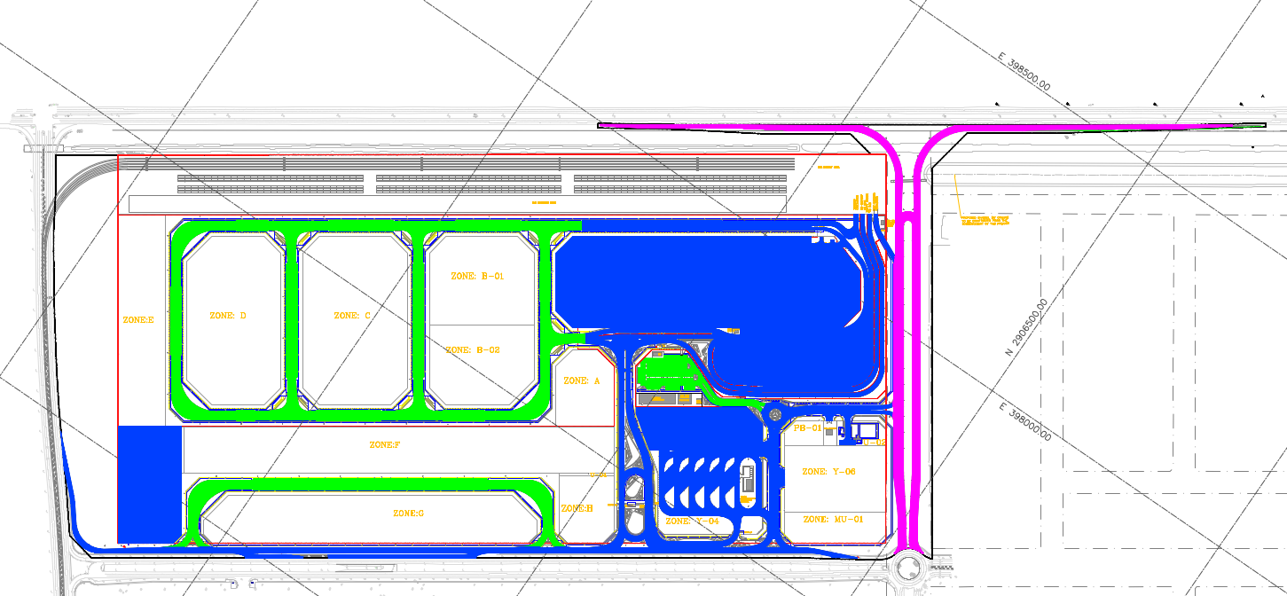
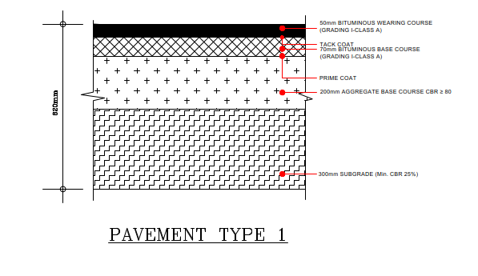
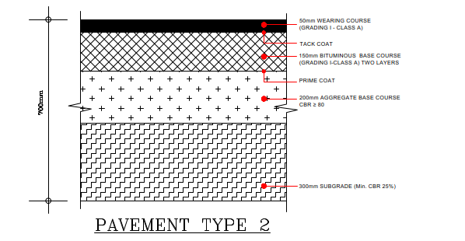
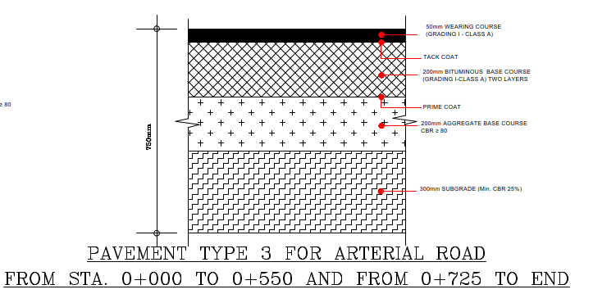
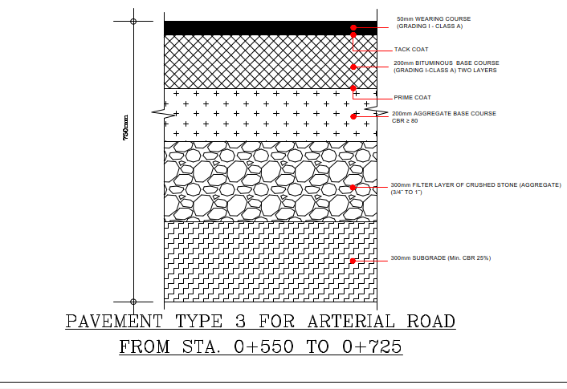
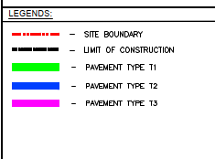
الاسفلت بالمشروع وانواعه

Slide 14
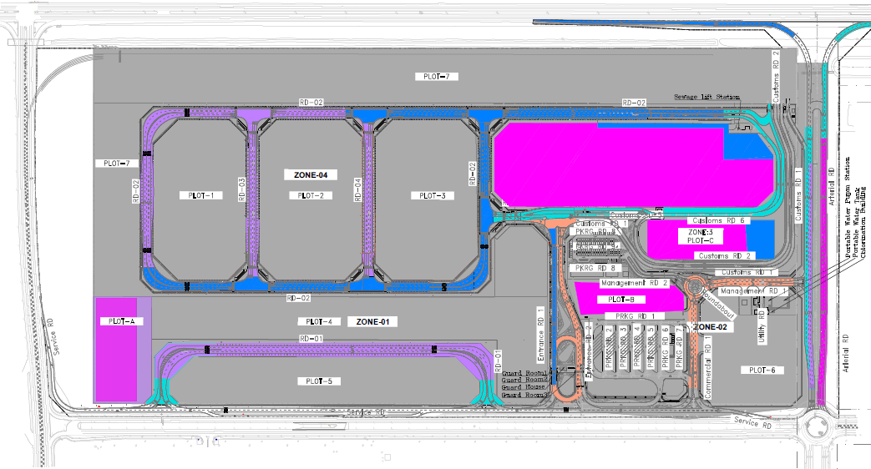
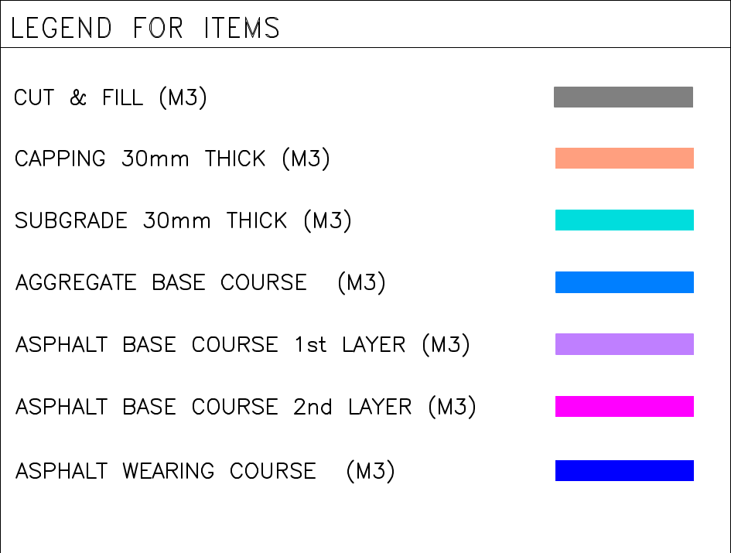
الأعمال الترابية وطبقات الطرق
كميات الاسفلت المنفذة
بلوت R1&A: 8,336.84 طن
طريق 03 زون 04 : 650 طن
بلوتD : 26,758.125 طن
الطريق الشرياني : 4,193.72 طن
بلوتC : 4,609.81 طن
بلوت B: 4,278.77 طن
طريق 04 : 650 طن
طريق 02 : 2550 طن
المجموع : 52,027.265 طن
المستودعات الاسفلتية
Plot A: 24,236 m²
Plot D : 87,215 m²
Plot C : 37,007 m²
Plot B : 16,649 m²

Slide 15
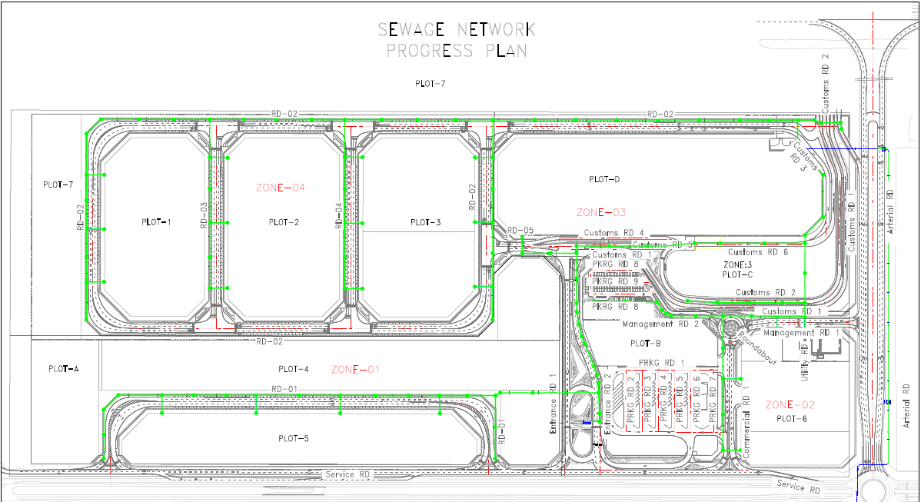

الأعمال الجارية:- أعمال شبكة الصرف الصحي
System / Network | Total Length (m) | Supplied (m) | Executed (m) | Supply % | Exec %
Sewerage (GRP) – Subtotal | 6,256.86 | 6,256.86 | 6,256.86 | 100.00% | 100.00%

Slide 16
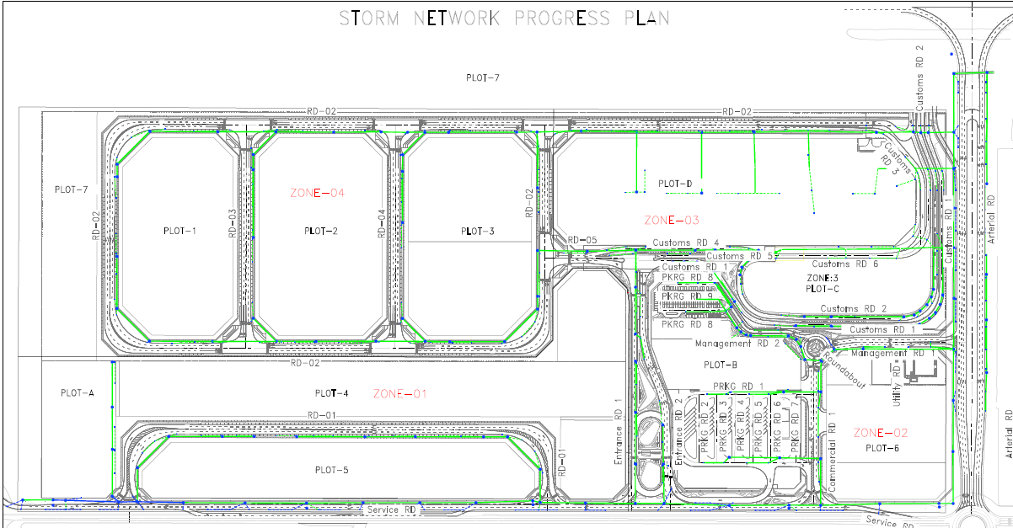
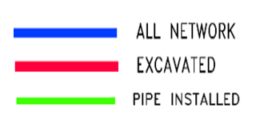
الأعمال الجارية:- أعمال شبكة صرف الامطار
System / Network | Total Length (m) | Supplied (m) | Executed (m) | Supply % | Exec %
Storm Drainage – Subtotal | 8,512.87 | 8,512.86 | 8,149.40 | 100.00% | 95.73%

Slide 17
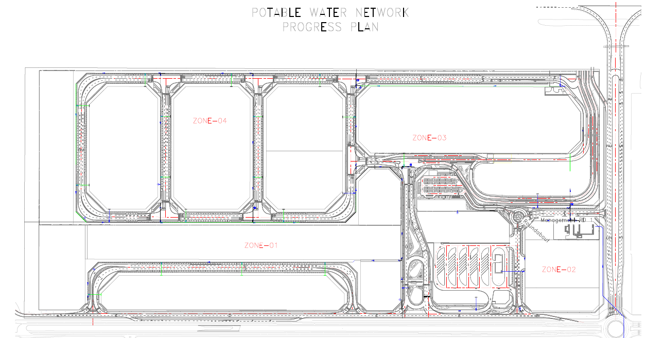
الأعمال الجارية:- أعمال شبكة مياه الشرب
System / Network | Total Length (m) | Supplied (m) | Executed (m) | Supply % | Exec %
Potable Water (HDPE) – Subtotal | 7,217.00 | 7,217.00 | 6,028.00 | 100.00% | 83.53%

Slide 18
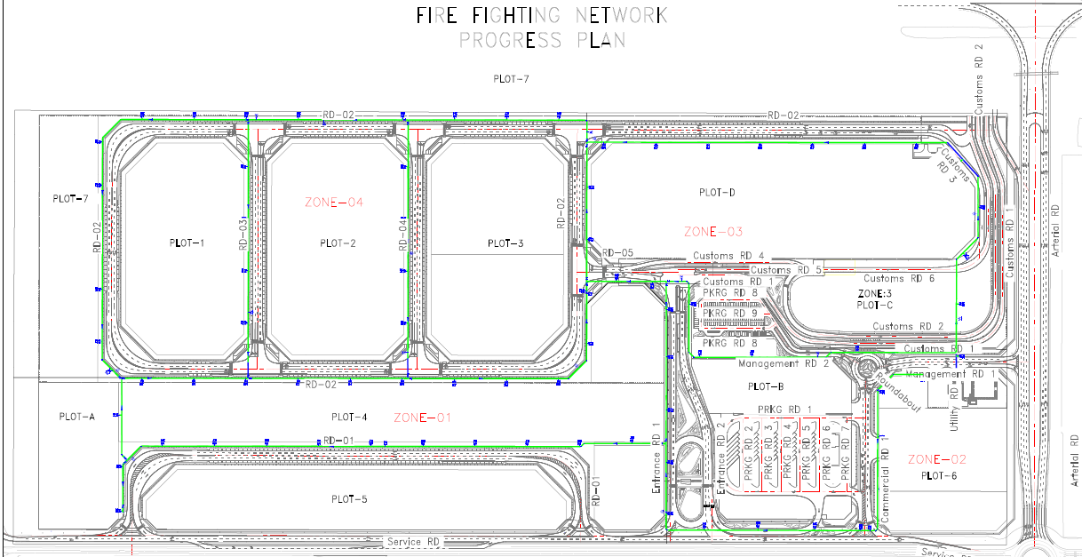
الأعمال الجارية:- أعمال شبكة إطفاء الحريق
Type | Quantity (m) | Supplied (m) | Executed (m) | %
Firefighting Pipe | 6,643.68 | 6,643.68 | 6,418.00 | 96.60%
Fire Hydrant | 82 | 12 | 12 | 14.63%

Slide 19
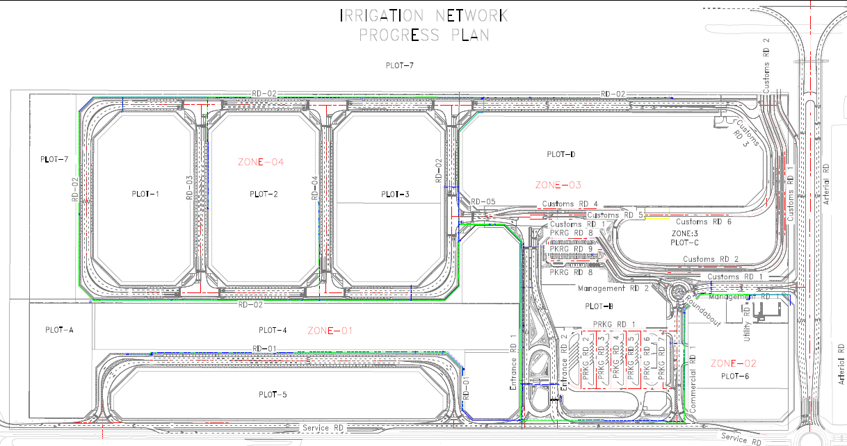
الأعمال الجارية:- أعمال شبكة الري
System / Network | Total Length (m) | Supplied (m) | Executed (m) | Supply % | Exec %
Irrigation (HDPE) – Subtotal | 17,678.00 | 11,528.00 | 5,053.00 | 65.21% | 28.58%

Slide 20
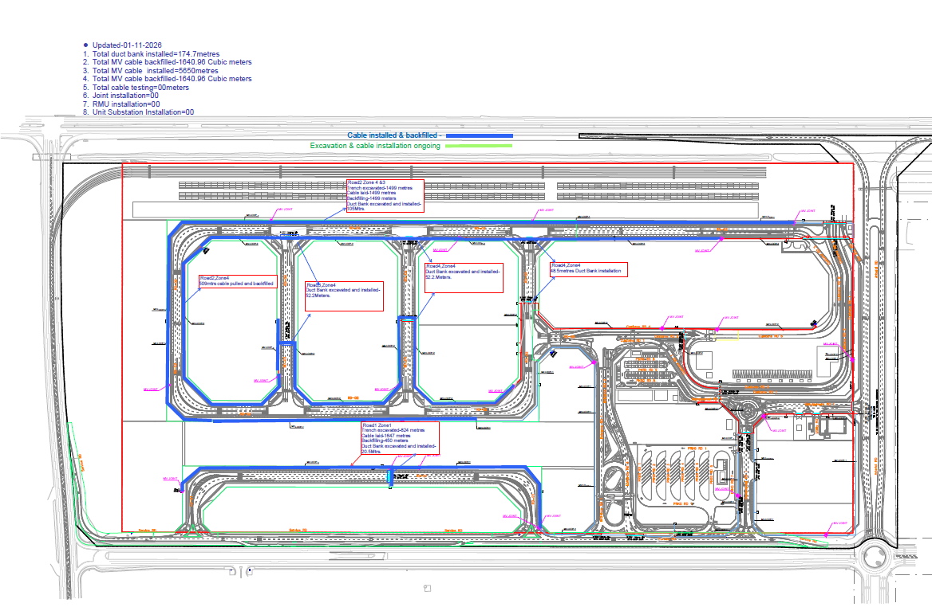
الأعمال الجارية:- أعمال شبكة الجهد المتوسط
MV NETWORK
ALL ZONES
Cables Length (m) | Loops (nr) | RMU (nr)
12,500 | 2 | 3
Delivery
12,600 | 0 | 0

Slide 21
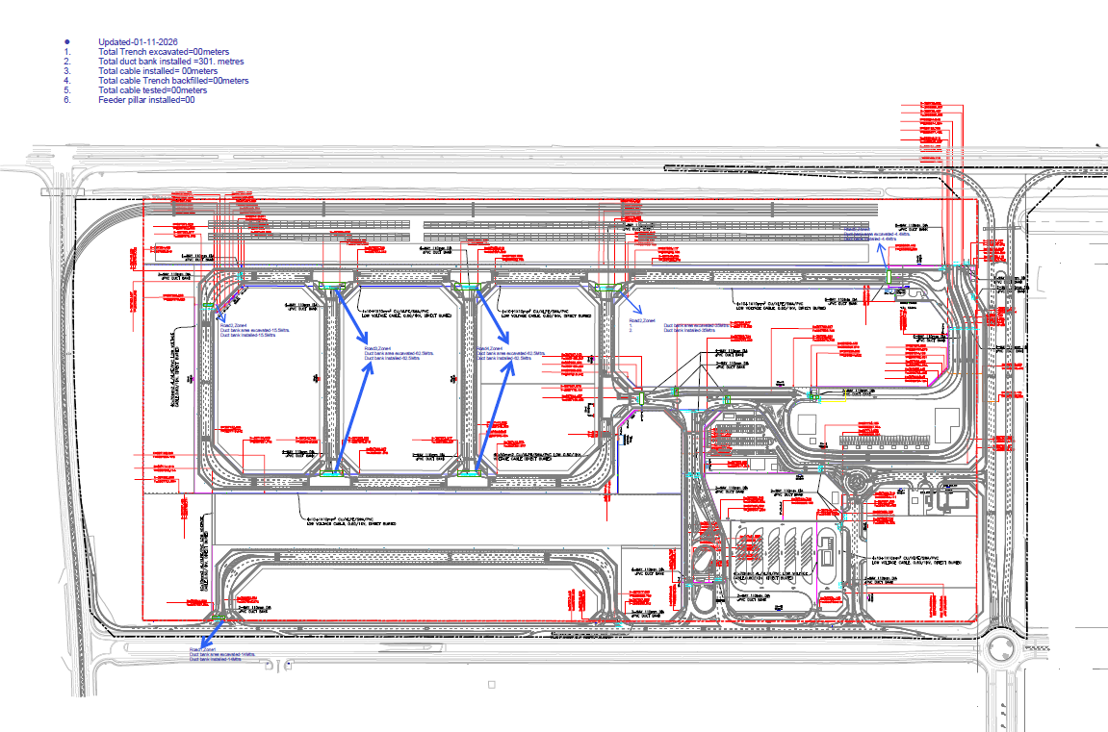

الأعمال الجارية:- أعمال شبكة الجهد المنخفض
LV NETWORK
ALL ZONES
Cables Length (m) | DISTB. PILLER (nr) | DISTB. PILLER (nr) | DISTB. PANELS UPS-CAMERA (nr) | KWH METER
18,920 | 7 | 7 | 3 | 9
Delivery
0 | 0 |  | 0 | 0

Slide 22
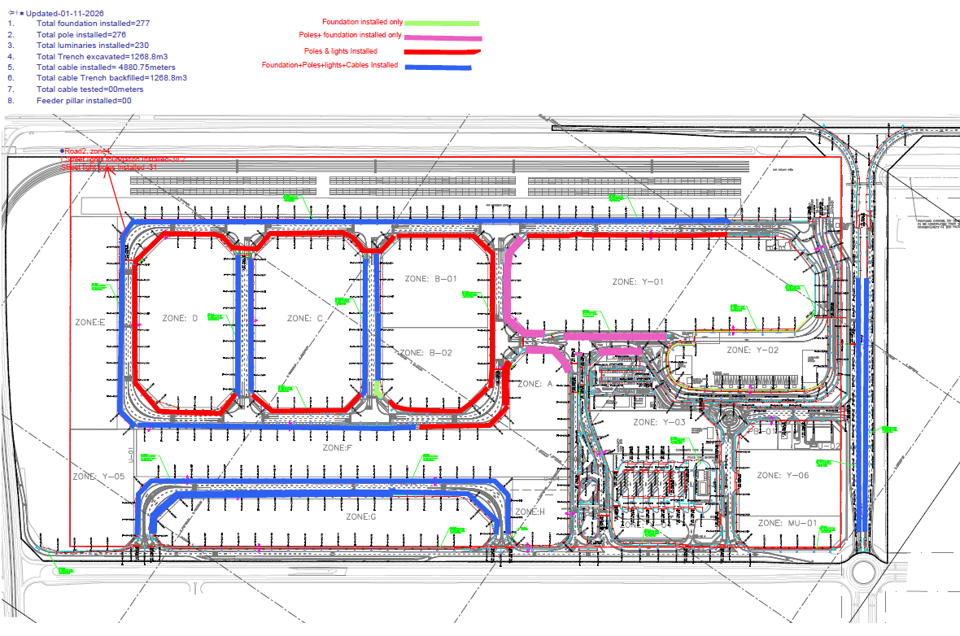
الأعمال الجارية:- أعمال شبكة الإنارة
 | Quantity (m) | Supplied (m) | Installed (Nos) | %
Poles | 565 | 380 | 298 | 52.74%

Slide 23
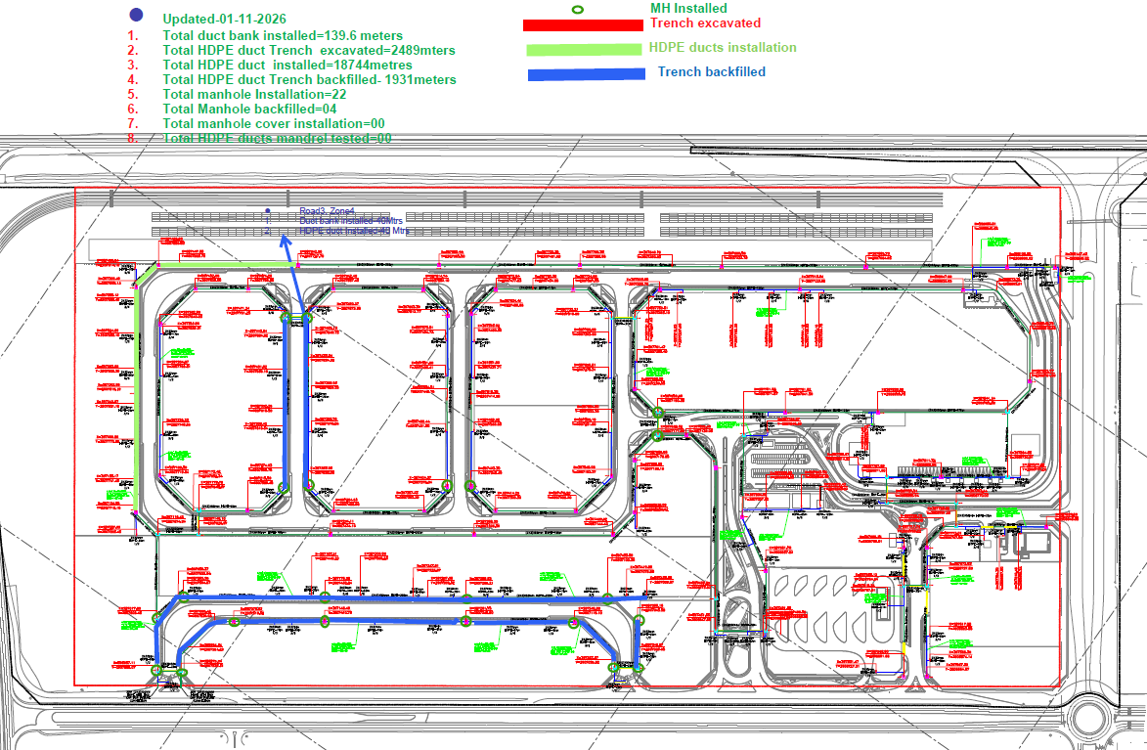
الأعمال الجارية:- أعمال الأتصالات

Slide 24
ملخص الافراد والمعدات في الموقع:
CONTRACTOR LABOUR
TRADE | Expats | Saudi
Lead Engineer | 7
General Labor / Assistant Surveyor / Safety Labors | 93
Operator & Driver | 241
Surveyors & Assistants | 5
Forman | 6
Steel Fixer | 30
Carpenter | 74
Plumber | 45
Welder | 0
Electrician | 3
Mason | 27
Laboratory Officer | 4
Office Boy | 2
TOTAL | 537
EQUIPMENT AVAILABLE AT SITE TODAY
TYPE | Working | Idle
Excavator (Poklains) | 15 | 1
Loader | 12 | 1
Compactor | 14 | 3
Dozer | 7 | 1
Dump Truck/Dumper | 7 | 2
Grader | 6 | 3
Water Tanker | 11 | 4
Disel Tanker | 1 | 2
Mobile Crane | 2 | 4
Forklift | 1 | 4
JCB | 4 | 4
Trailer | 146 | 2
High Bed/Low Bed | 1 | 2
Bobcat | 3 | 1
Ready-mix Conc. Truck | 0 | 4
Boom Truck | 5 | 4
Jumbo Car (Diyana) | 3 | 2
Ambulance | 3 | 2
Asphalt Paver | 3 | 3
Water Pump | 24 | 4
Tower light | 48 | 2
TOTAL ACTUAL | 330

Slide 25
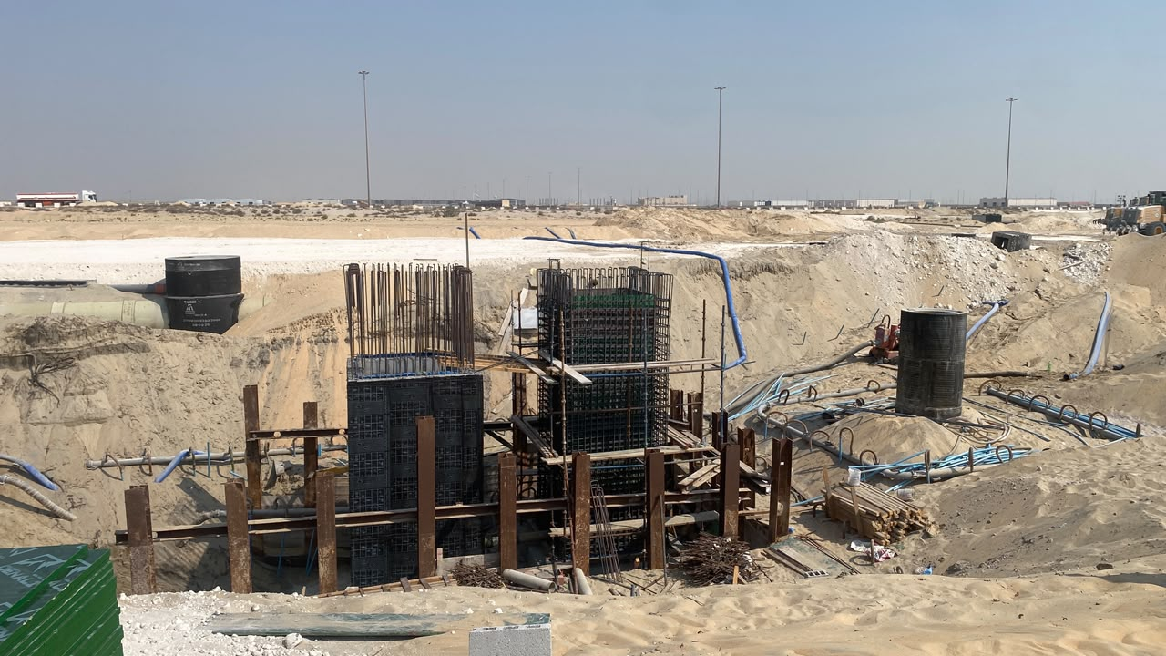
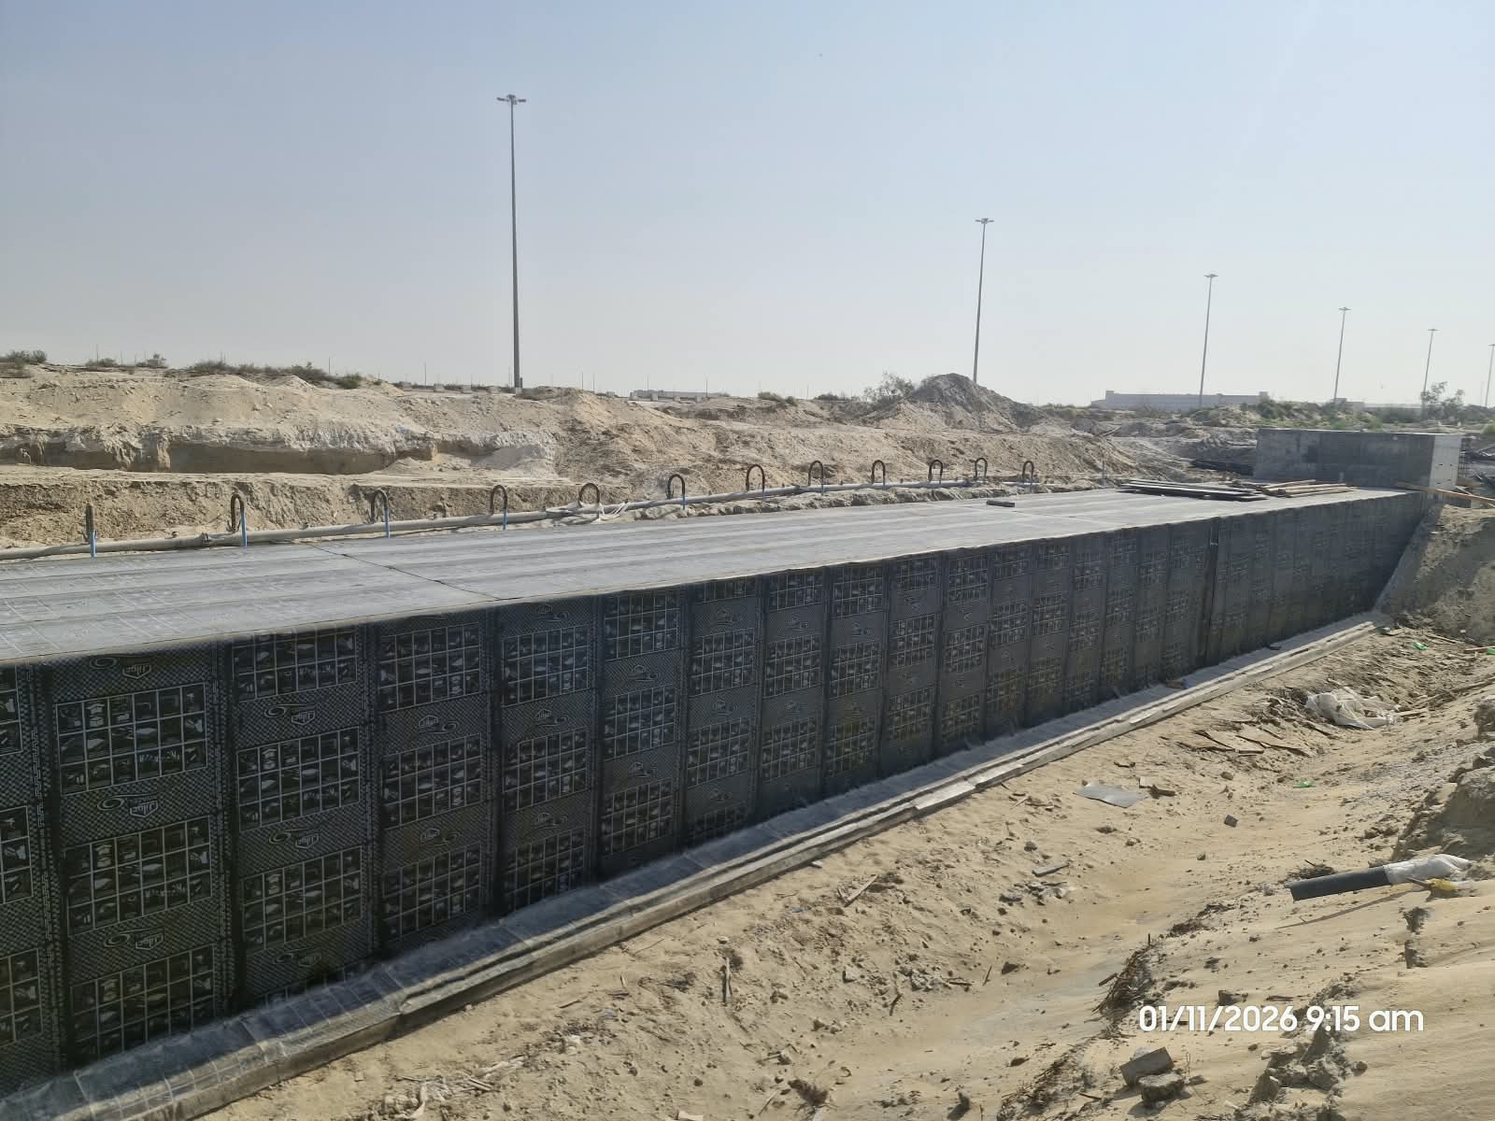
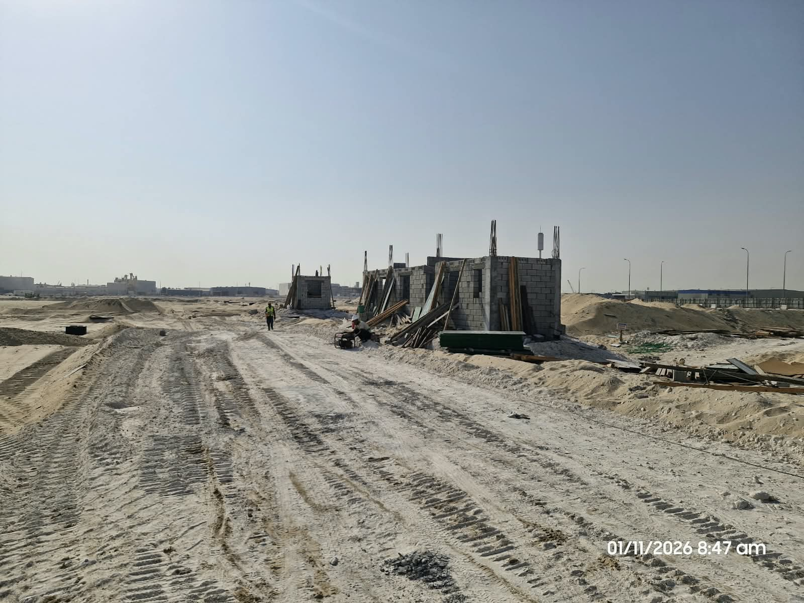
أبرز الاعمال المنجزة
أعمال الخرسانات محطة الرفع | أعمال عزل العبارة
 | Block Work for Guard Room

Slide 26
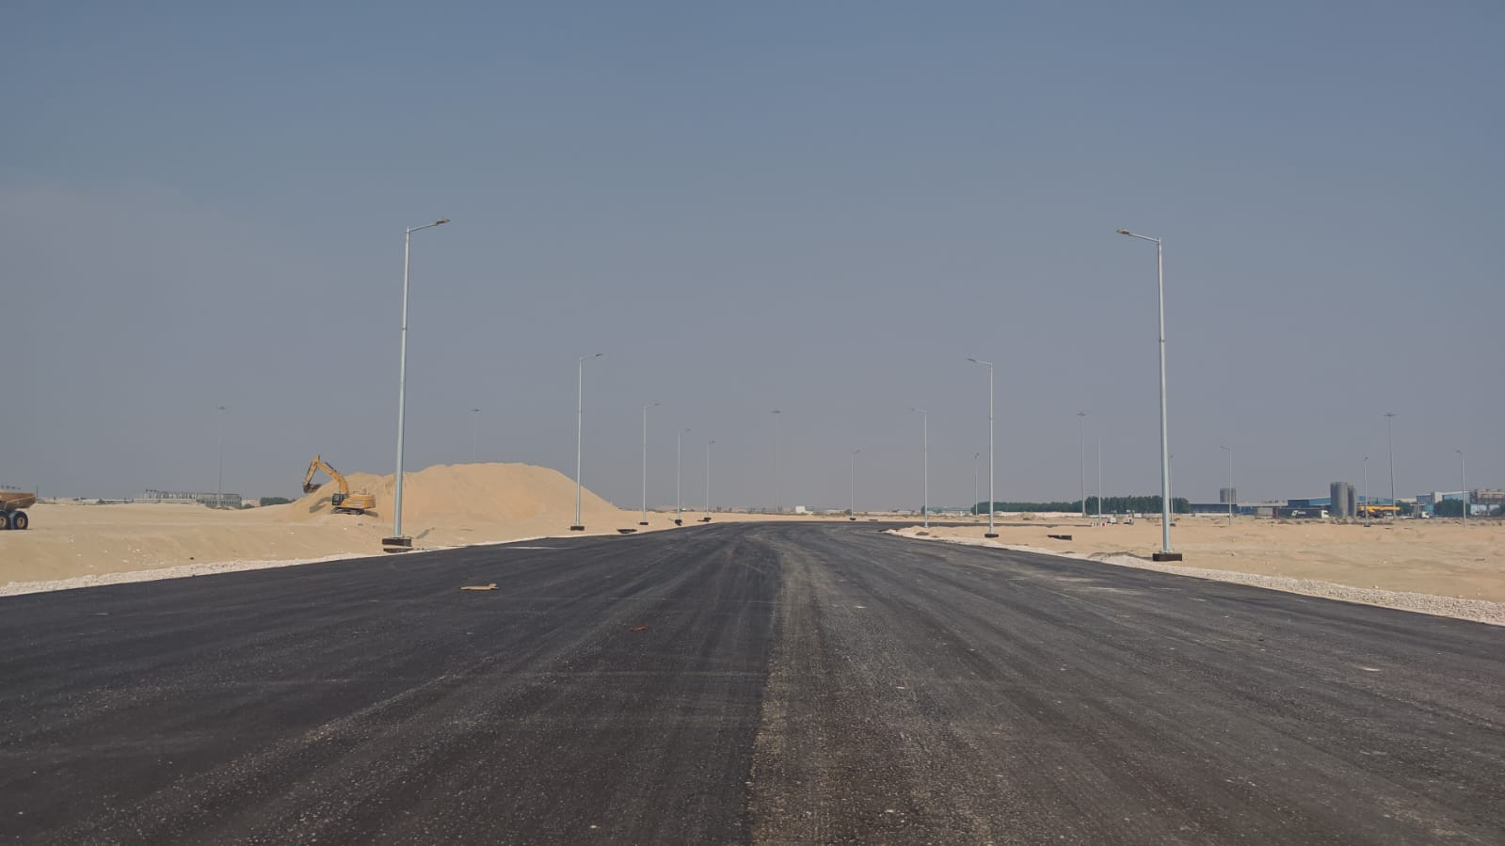
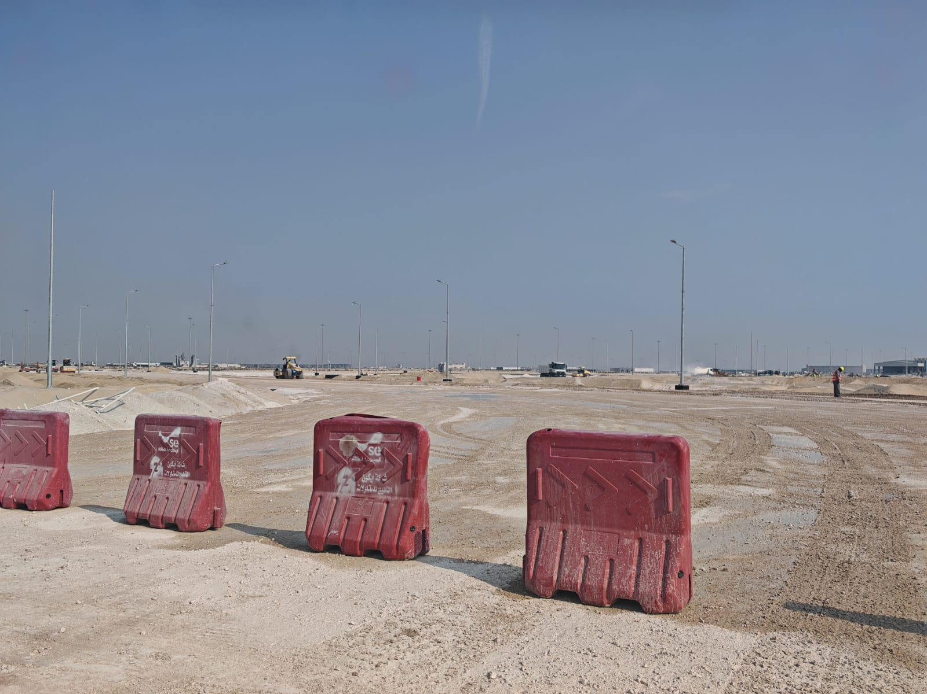
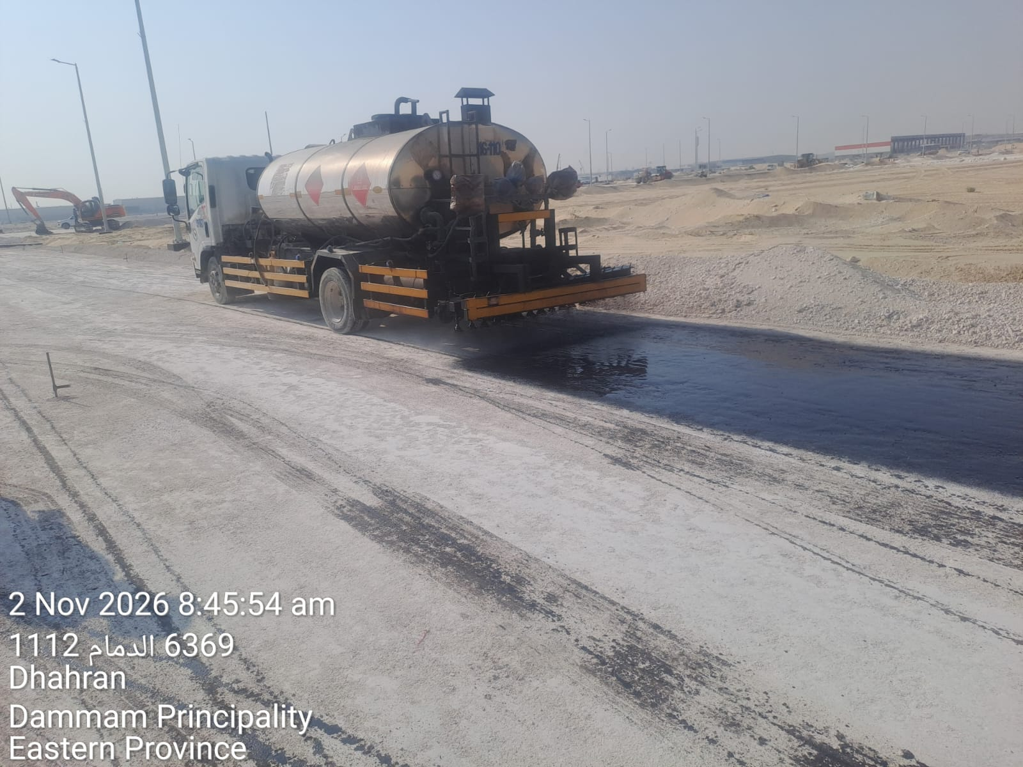
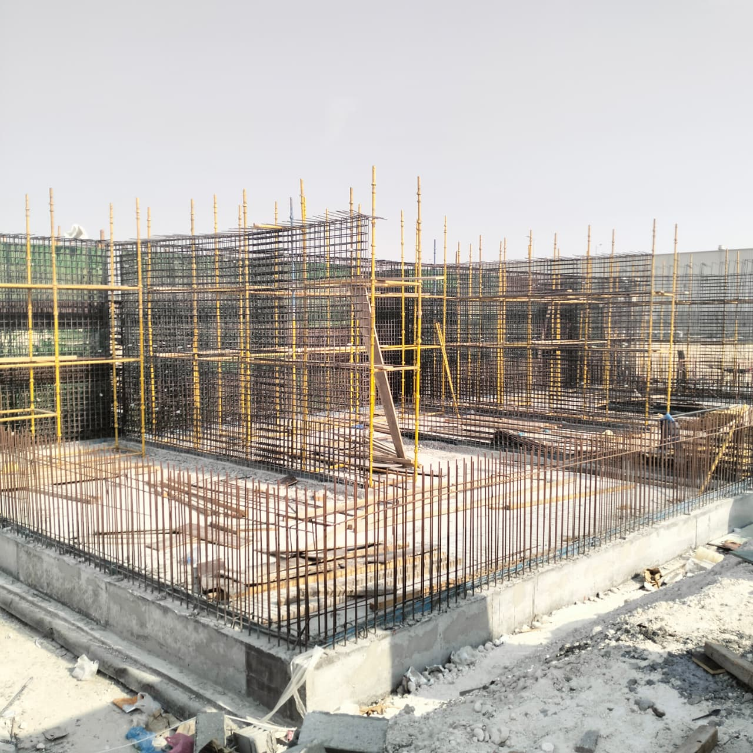
أبرز الاعمال المنجزة
الاسفلت و أعمدة الإنارةطريق 2 زون 4 | طبقة ABCطريق 2 زون 4
Spray MC1 Road 2 | اعمال الحدادة في الخزان

Slide 27
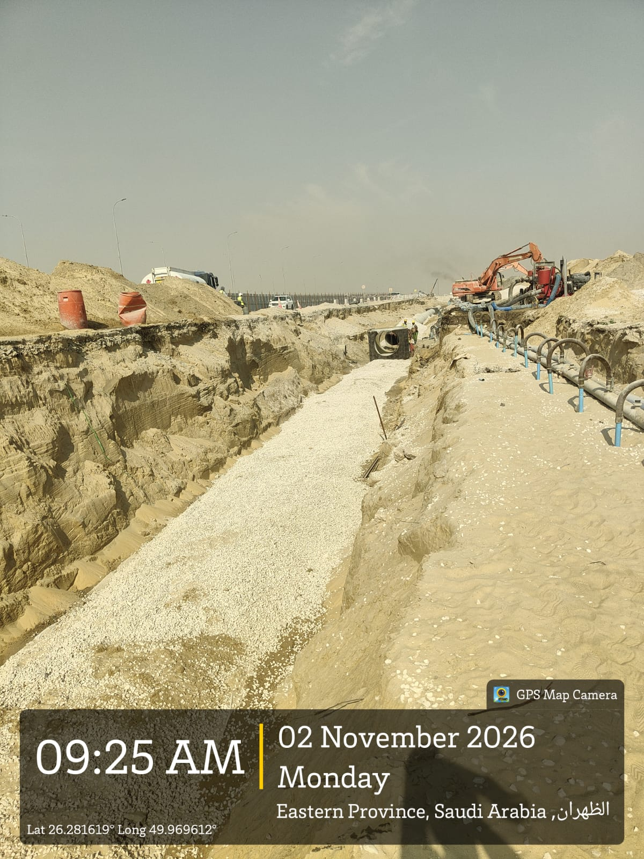
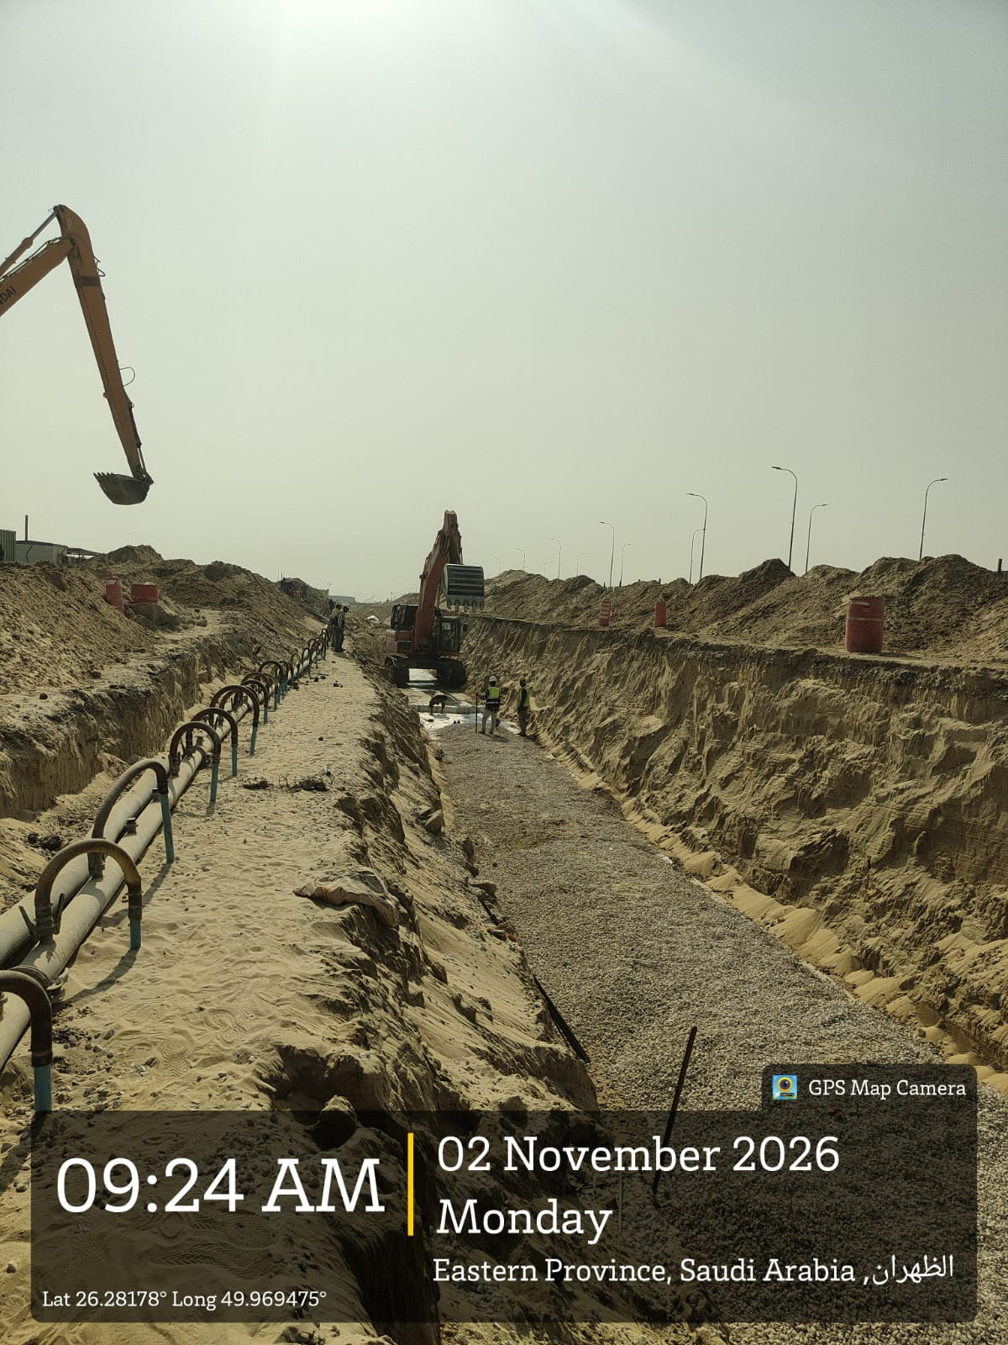
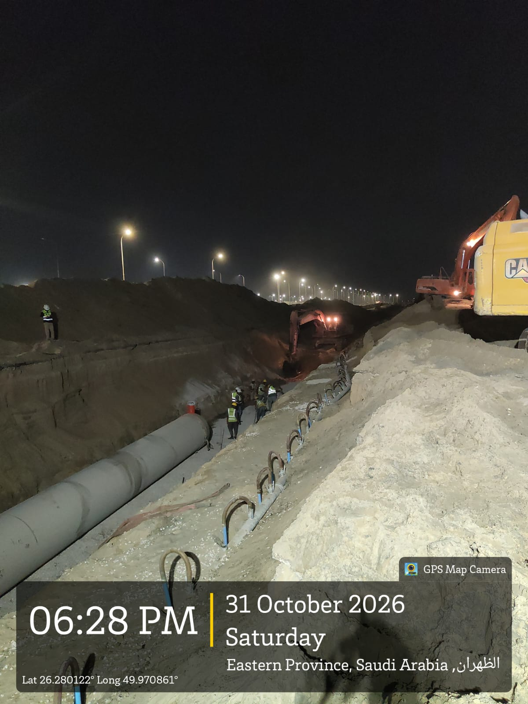
أبرز الاعمال المنجزة
Storm Works at Service Road

